Slide 1










Team:-
TEEN TITANS
FARDEEN KHAN
GROUP LEADER
GU Mail I’d : fardeen.24sece1290012@galgotiasuniversity.ac.in
ADMISSION NO. : 24SECE1290012
Introducing Our Team
AKSHAT TRIVEDI
GROUP MEMBER
GU Mail I’d : akshat.24sece1290008@galgotiasuniversity.ac.in
ADMISSION NO. : 24SECE1290008
GARV SAXENA
GROUP MEMBER
GU Mail I’d : garv.24sece1290030@galgotiasuniversity.ac.in
ADMISSION NO. : 24SECE1290030
RAYYAN ALI KHAN
GROUP MEMBER
GU Mail I’d : rayyaan.24sece1290027@galgotiasuniversity.ac.in
ADMISSION NO. : 24SECE1290027

Slide 2
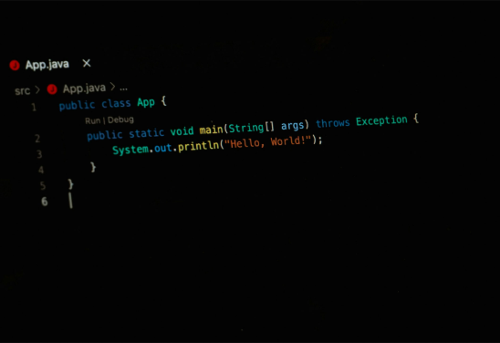
Java Command-Line Quiz Project
This presentation guides you through building a Java quiz app. Explore file handling, conditionals, and loops used in this beginner-friendly project.

Slide 3








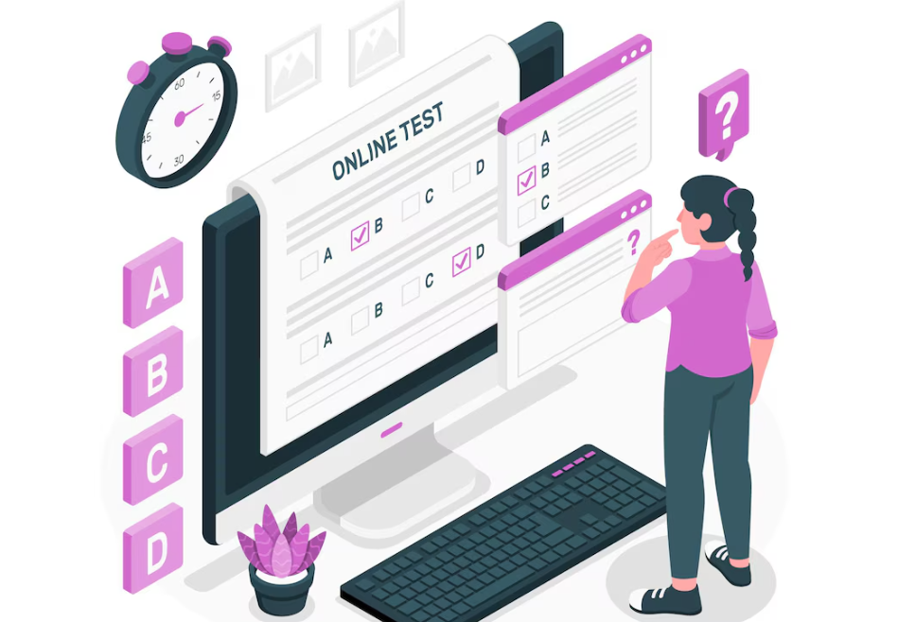




Approach
Read quiz questions and answers from a text file formatted as :-
Use Java’s Scanner class for user input and FileReader to load questions.
Iterate through questions, validate answers, and track scores using loops and conditional statements.
Display immediate feedback and final results.
Expected Results: A functional quiz application that administers 5-10 questions, validates answers, calculates scores, and provides a user-friendly command-line interface.
Question|Option A |Option B|Option C|CorrectAnswer.

Slide 4







WORKFLOW FILE
01
Title & Overview
05
Sample Output
Project title, developer name, and brief purpose.
Question 1: What is 5+8?
A) 13 | B) 14 | C) 12 | D) 8
Your answer: A
Correct!
Final Score: 1/1
Text File Format
02
Example: What is 5+8?
A) 13 | B) 14 | C) 12 | D) 8
Application Workflow
06
Future Enhancements
03
Start → Load Questions → Display Question → Get Input → Validate → Update Score → Repeat → Show Final Score → End.
Add timers, difficulty levels, or GUI (for intermediate learners).
Code Structure
Complete Workflow Steps
04
4.1) Main.java: Contains the main method to run the quiz.
4.2) Methods: loadQuestions(), displayQuestion(), validateAnswer().
07
7.1) Track score and advance to next question
7.2) Display final score at end
7.3) End program cleanly

Slide 5
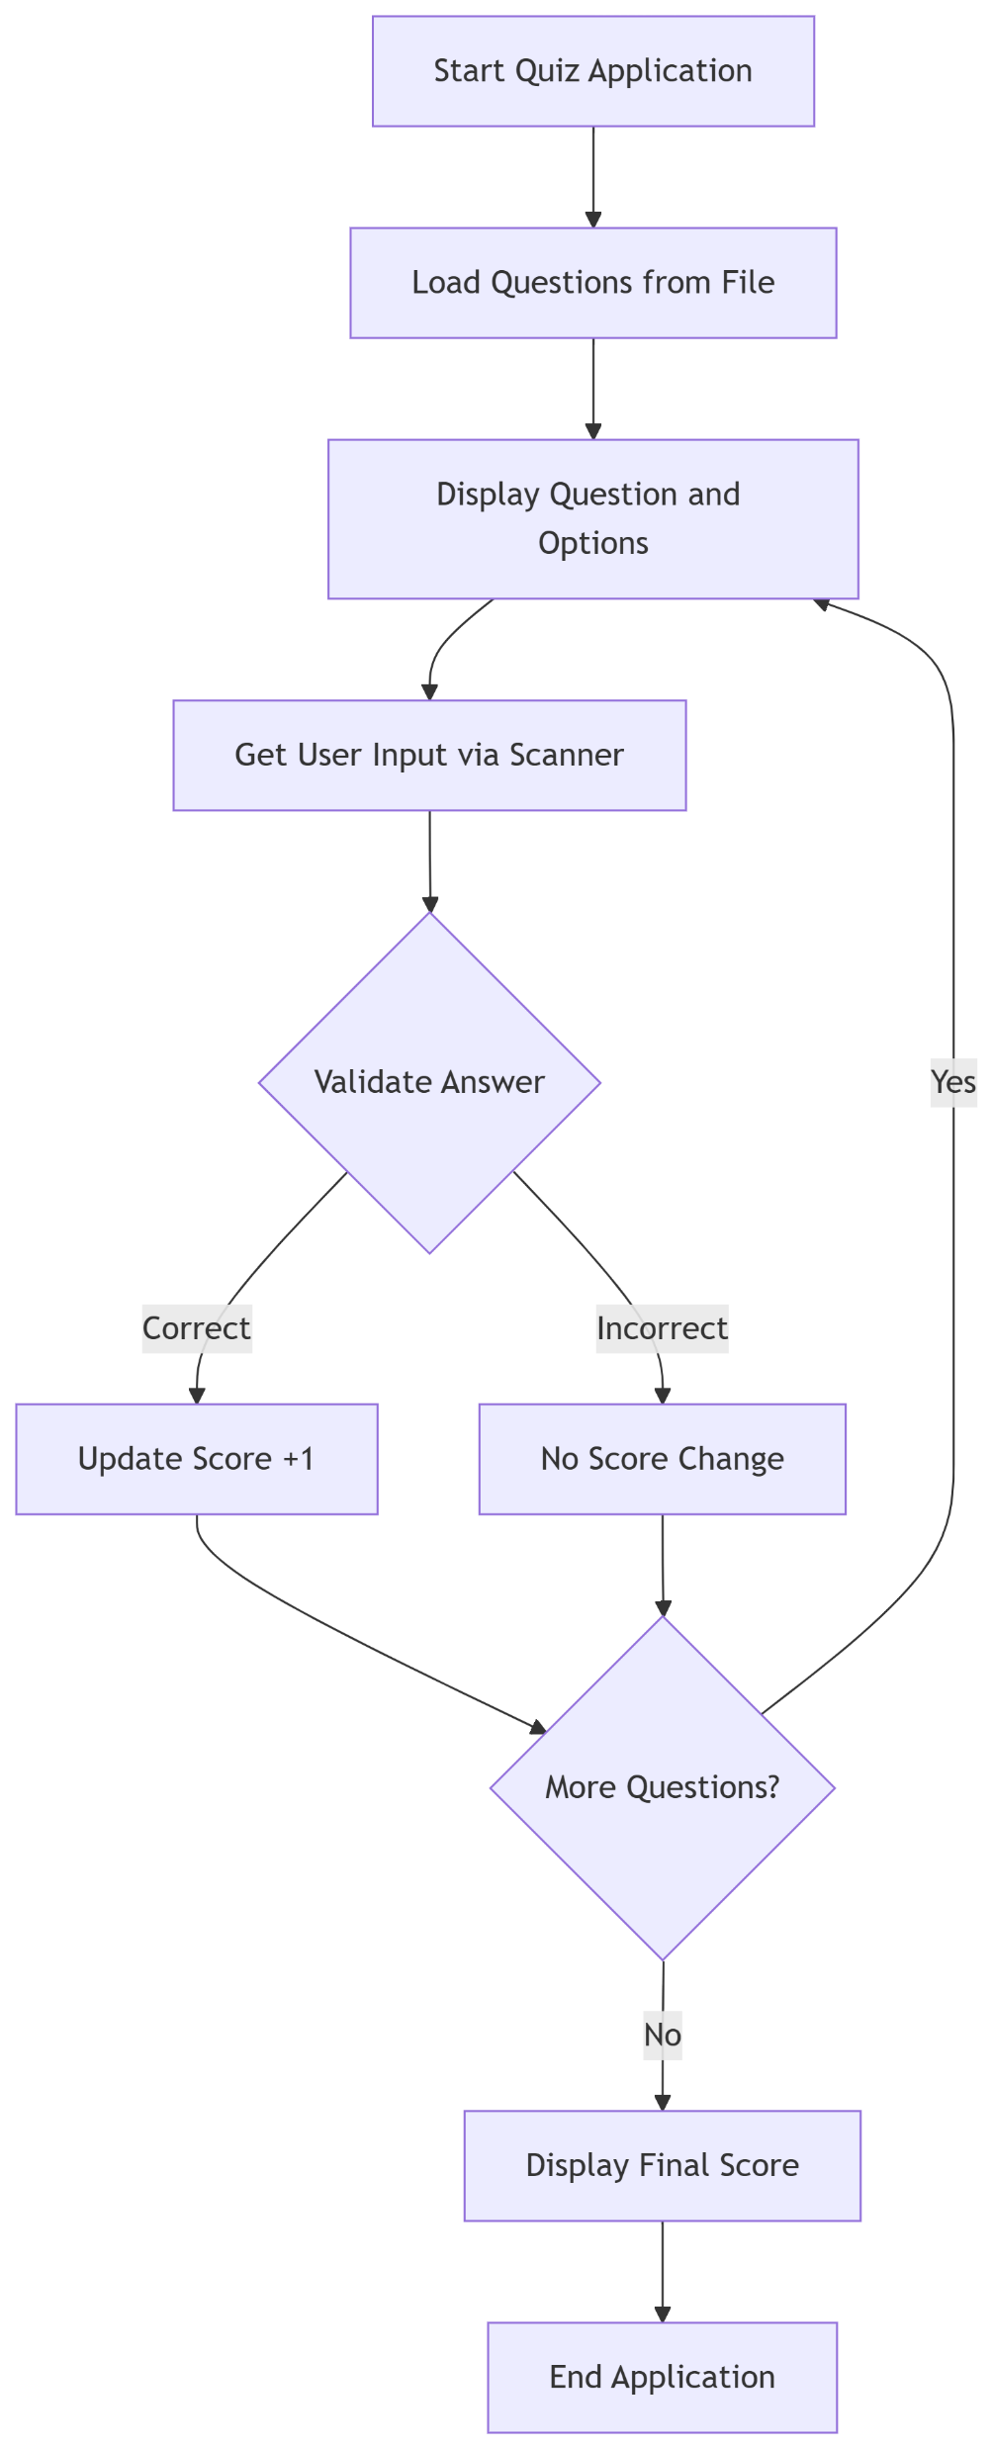
Flow chart :

Slide 6

Why We Built This:
We created QuickQuiz to practice core Java concepts (file I/O, loops, conditionals) while making a fun tool for classmates to study for exams. It helped me learn error handling and user input validation—plus, it’s a great foundation for future upgrades!
Perfect For:
Beginner Java learners looking for a hands-on project with clear, practical applications.

Slide 7

Conclusion
QuickQuiz successfully demonstrates how core Java concepts—like file handling, loops, and user input validation—can be applied to create a functional and engaging command-line quiz application. Designed with beginners in mind, this project not only reinforces fundamental programming skills but also provides a scalable foundation for future enhancements, such as timers, high-score tracking, or even a GUI(Graphical User Interface) upgrade.

